Slide 1
Management & Organisational Behaviour 4
Module Code: ENGE08016

Slide 2
Motivation Theories

Slide 3

Learning Objective
Define what motivation is in relation to the workplace
Understand the different motivation theories
Fayol's and Mintzberg's Approaches to Management Roles: Significance of Motivation and Structure in Organizations
Image Source: Institute of Entrepreneurship Development

Slide 4

Organizational Motivation
Organizational motivation refers to the process of incentivizing and energizing individuals or groups within an organization to act in a certain way, direct their efforts towards achieving specific goals, and sustain their efforts over time.
It involves understanding and influencing the factors that drive employees to be engaged, committed, and productive in their work within the organizational setting
Image Source: LinkedIn

Slide 5
Organizational Motivation
Key aspects of organizational motivation include:
Goal Orientation: Employees are motivated by organizational objectives, personal aspirations, and a desire to contribute to the accomplishment of goals that align with their values and beliefs.
Incentives and Rewards: Providing rewards, recognition, promotions, bonuses, or other incentives based on performance can motivate employees to put in their best effort and achieve desired outcomes.
Job Satisfaction: A positive work environment, meaningful work, opportunities for growth, and good relationships at work can enhance job satisfaction, contributing to higher motivation levels among employees.
Employee Engagement: Engaged employees are motivated to invest their discretionary effort to contribute to the success of the organization. Engagement is fostered through open communication, employee involvement, and opportunities for personal and professional development.
Effective Leadership: Leadership that provides clear direction, sets expectations, offers support, and encourages employee growth and empowerment plays a crucial role in motivating individuals and teams.

Slide 6
Organizational Motivation
Key aspects of organizational motivation include:
Intrinsic and Extrinsic Motivation: Intrinsic motivation comes from within an individual and is driven by personal satisfaction, interest in the work, and the desire to achieve. Extrinsic motivation is external and arises from rewards, recognition, or punishments.
Psychological Factors: Motivation is influenced by individual perceptions, attitudes, beliefs, and expectations. Factors such as self-esteem, self-efficacy, and perceived fairness also impact motivation.
Continuous Feedback and Communication: Providing regular and constructive feedback, clear communication of expectations, and fostering a culture of openness and transparency can enhance motivation by enabling employees to understand their progress and areas for improvement.
Organizational motivation is a dynamic process influenced by a variety of internal and external factors. Effective management involves understanding these factors and creating strategies and initiatives to inspire and sustain high levels of motivation, resulting in increased productivity, employee satisfaction, and overall organizational success.

Slide 7
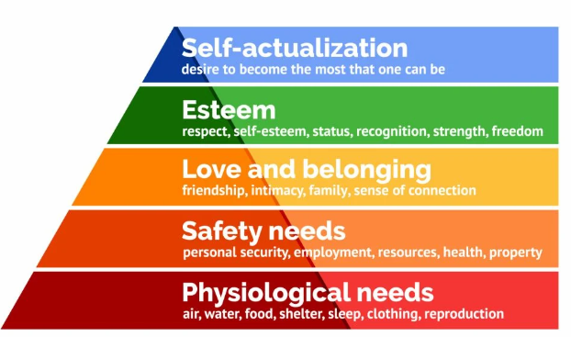
Maslow's Hierarchy of Needs
Maslow's Hierarchy of Needs is a psychological theory proposed by Abraham Maslow in 1943, which presents a five-tier model of human needs, often depicted as a pyramid.
The theory suggests that people are motivated to fulfil these needs in a hierarchical order, starting from the most basic and progressing towards higher-level needs as lower-level needs are satisfied.
Image Source: Simply Psychology

Slide 8
Maslow's Hierarchy of Needs
Physiological Needs: At the base of the pyramid are the basic physiological needs necessary for human survival, including air, water, food, shelter, clothing, and sleep. Individuals seek to satisfy these needs before moving on to higher levels.
Safety Needs: Once physiological needs are met, individuals focus on safety and security needs, seeking stability, order, and protection from harm. This includes physical safety, health, financial security, employment, and property.
Social Needs: After safety, people strive for social connections and a sense of belonging. This level encompasses interpersonal relationships, friendships, and the desire to be a part of a group or community.
Esteem Needs: Once social needs are fulfilled, individuals seek to achieve a sense of self-esteem and recognition from others. This includes feelings of accomplishment, confidence, respect from others, and the need for prestige, recognition, and status.
Self-Actualization: At the top of the pyramid is self-actualization, representing the need for personal growth, realization of one's potential, and achieving personal aspirations. This includes creativity, problem-solving, morality, acceptance of facts and realities, and the ability to find purpose and meaning in life.
Image Source: Simply Psychology

Slide 9
Maslow's Hierarchy of Needs
Maslow's theory suggests that individuals move up the hierarchy as lower-level needs are met. However, not everyone reaches the top level, as progress can be influenced by various factors such as personal circumstances, culture, and individual differences.
It's important to note that Maslow's Hierarchy of Needs is a theoretical framework and doesn't imply a strict, linear progression.
In reality, individuals may experience multiple needs at the same time and might move up and down the hierarchy based on their circumstances and life experiences.
Image Source: Simply Psychology

Slide 10
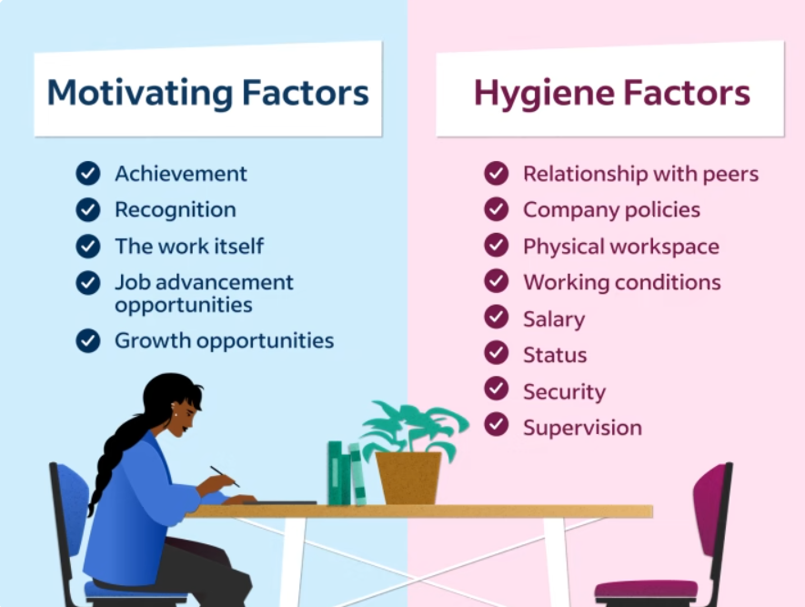
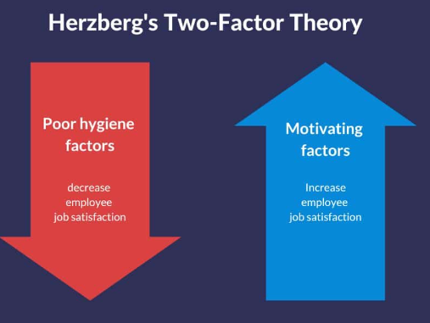
Herzberg's Two-Factor Theory (Motivation-Hygiene Theory)
Herzberg's Two-Factor Theory, also known as the Motivation-Hygiene Theory, was proposed by Frederick Herzberg in the late 1950s. This theory is widely used to understand workplace motivation and job satisfaction.
Herzberg identified two sets of factors that influence people's satisfaction and dissatisfaction in the workplace, and these factors are distinct and independent of each other:
Image Source: Indeed
Image Source: TSW Training

Slide 11

Herzberg's Two-Factor Theory (Motivation-Hygiene Theory)
Hygiene Factors (Dissatisfiers):
Hygiene factors are related to the work environment and are essential for preventing dissatisfaction. When these factors are lacking or inadequate, employees become dissatisfied, but their presence doesn't necessarily motivate or satisfy individuals.
Key hygiene factors include:
Job Security: A stable work environment and assurance of job continuity.
Working Conditions: Factors like the quality of the workspace, lighting, temperature, and overall physical working conditions.
Company Policies: Fair rules, policies, and procedures that are consistently implemented and followed.
Interpersonal Relationships: Quality of relationships with supervisors, colleagues, and subordinates.
Supervision: The competence and behaviour of managers or supervisors, and the level of guidance and support they provide.

Slide 12

Herzberg's Two-Factor Theory (Motivation-Hygiene Theory)
Motivators (Satisfiers):
Motivators are intrinsic to the job itself and are directly related to the work and how employees perceive their roles. The presence of motivators leads to job satisfaction and increased motivation.
Key motivators include:
Achievement: The sense of accomplishment, progress, and successful completion of challenging tasks.
Recognition: Acknowledgment and appreciation for one's contributions and efforts.
Work Itself: The nature of the job, the tasks, responsibilities, and opportunities for growth and development.
Responsibility: The extent of control and decision-making authority an employee has over their work.
Advancement: Opportunities for career growth, promotions, and increased responsibilities.

Slide 13
Herzberg's Two-Factor Theory (Motivation-Hygiene Theory)
Herzberg's theory suggests that organizations should focus on both hygiene factors and motivators to create a work environment that not only prevents dissatisfaction but also fosters job satisfaction and motivation.
Simply improving hygiene factors may prevent dissatisfaction but does not necessarily motivate employees to excel. To truly motivate employees, organizations need to provide challenging and fulfilling work that aligns with individuals' intrinsic values and goals.
Image Source: Indeed
Image Source: TSW Training

Slide 14
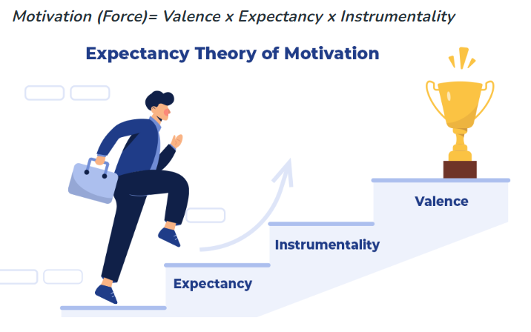
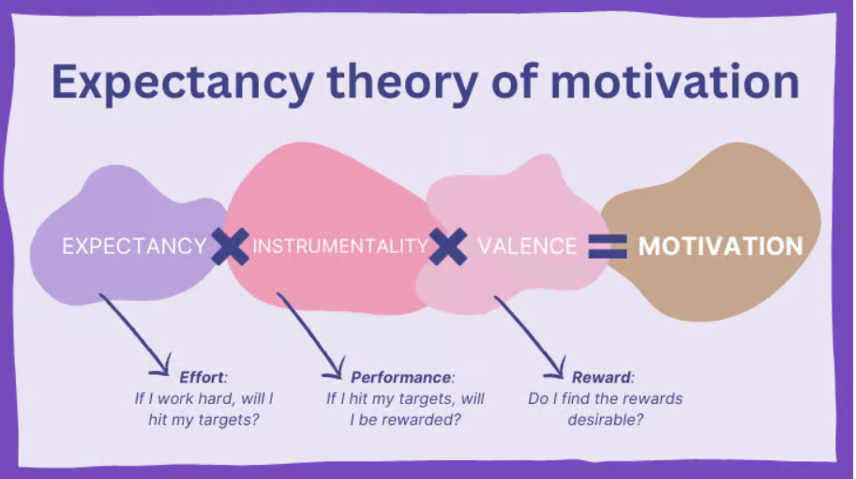
Expectancy Theory
Expectancy Theory is a psychological and motivational theory that was proposed by Victor Vroom in 1964.
It is a cognitive-based theory that explains how individuals make decisions regarding their behaviour in various situations, particularly in the workplace. The theory suggests that people are motivated to act in a certain way based on the expectation that their efforts will lead to a desired outcome and the belief that they can perform the required actions to achieve that outcome.
Image Source: Geeksforgeeks
Image Source: logrocket frontend analytics

Slide 15
Expectancy Theory
The theory comprises three key components:
Expectancy (E1):
This refers to an individual's belief or perception that their efforts will lead to a certain level of performance. It is the belief that putting in effort will result in successful performance. The expectancy can range from 0 to 1, where 0 signifies no confidence, and 1 signifies full confidence.
Instrumentality (E2):
Instrumentality is the belief that successful performance will lead to a specific outcome or reward. It is the perception of a link between performance and the attainment of an outcome. Similar to expectancy, instrumentality is also measured on a scale from 0 to 1.
Valence (V):
Valence refers to the value an individual places on the outcome or reward. It reflects an individual's preference or desire for a particular outcome. Valence can be positive, negative, or zero, indicating attraction, aversion, or indifference to the outcome.
The theory posits that individuals weigh these three components and make a rational decision about whether to engage in a particular behaviour based on their expectations of the outcomes.

Slide 16
Expectancy Theory
The overall motivational force (MF) to engage in a behaviour is calculated using the following formula:
MF = E1 X E2 X V
If any component (expectancy, instrumentality, or valence) is perceived as zero, the overall motivational force will also be zero.
Expectancy Theory suggests that employees will be motivated to put in effort and perform well when they believe that their efforts will lead to successful performance (expectancy), that successful performance will lead to rewards (instrumentality), and that the rewards are personally valuable (valence).
Organizations can enhance employee motivation by ensuring that employees perceive a clear connection between effort, performance, and rewards, and by aligning the rewards with employees' preferences and goals.

Slide 17
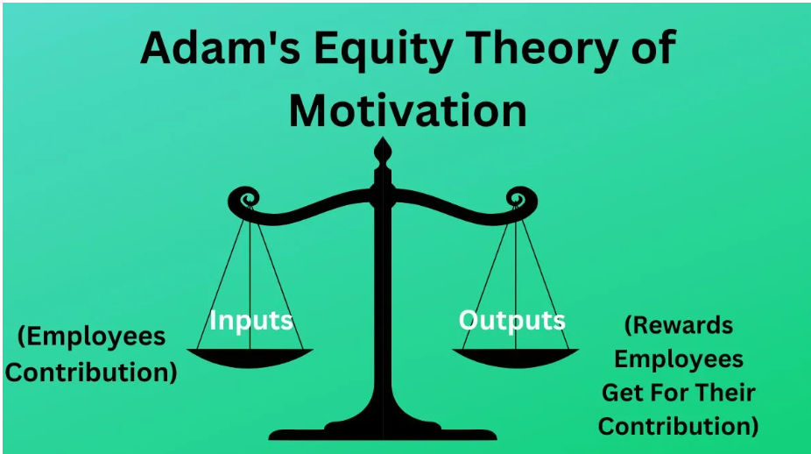
Equity Theory
The Equity Theory, developed by J. Stacy Adams in the early 1960s, is a psychological theory that focuses on fairness and justice in social exchanges, particularly within the workplace.
The theory suggests that individuals are motivated by a desire to maintain a sense of fairness and equity in their relationships and interactions with others.
People compare their inputs (effort, contributions, etc.) and outcomes (rewards, benefits) with those of others in similar situations
Image Source: Google

Slide 18
Equity Theory
The key components of the Equity Theory are:
Inputs: Inputs are what an individual perceives they contribute to a situation, such as effort, time, skills, education, and dedication to the job.
Outcomes: Outcomes are what an individual perceives they receive from a situation, such as pay, recognition, promotions, job satisfaction, and benefits.
Comparison: Individuals compare their ratio of inputs to outcomes with the ratio of someone else (referent other) to determine whether they are being treated fairly.
Equity: Equity is achieved when an individual perceives that their input-to-outcome ratio is similar to that of the referent other. This perception of fairness motivates satisfaction and encourages continued positive behaviour.
Inequity: Inequity occurs when an individual perceives an imbalance in their input-to-outcome ratio compared to the referent other. Inequity can manifest as under-reward (receiving less for more input) or over-reward (receiving more for less input).

Slide 19
Equity Theory
Individuals can experience one of three states:
Equity Distress: When individuals perceive inequity, they may experience distress, leading to actions to restore equity.
Under-reward Inequity Tension: Feeling that their outcomes are less than what they deserve based on their inputs.
Over-reward Inequity Tension: Feeling that their outcomes are more than what they deserve based on their inputs.
To restore equity, individuals can adjust their inputs (reduce effort, slack off), adjust their outcomes (negotiate for better rewards), or change their perceptions (justify the inequality by considering the referent's unique circumstances).
In the workplace, understanding and addressing perceptions of equity are crucial for employee motivation, job satisfaction, and organizational harmony. Organizations should strive to maintain a fair and just environment where employees believe that their contributions are appropriately rewarded, promoting a positive work culture and higher levels of employee engagement.

Slide 20
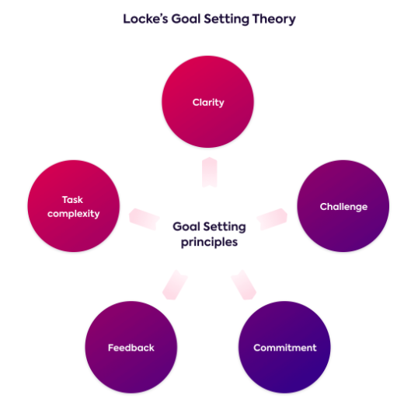
Goal-Setting Theory
The Goal Setting Theory, proposed by Edwin Locke and Gary Latham in the late 1960s, is a motivational theory that emphasizes the importance of setting clear and specific goals in enhancing employee performance and motivation.
According to this theory, individuals are motivated to achieve goals that are challenging, achievable, and specific.
Image Source: Lucidity

Slide 21
Goal-Setting Theory
Clarity: Goals should be specific and clear rather than vague or general. Well-defined objectives provide direction and clarity for actions.
Challenge: Goals should be challenging enough to motivate individuals to exert effort and push their capabilities but not so difficult that they become unattainable or demotivating.
Commitment: Individuals should be committed to achieving the goals. This commitment arises from understanding the goals, believing in their attainability, and being personally invested in them. For goals to motivate, they need to be accepted and agreed upon by the individuals who are tasked with achieving them. Involving employees in the goal-setting process increases their commitment and motivation.
Image Source: Lucidity

Slide 22
Goal-Setting Theory
Feedback: Regular feedback on progress towards the goals is essential. Individuals need to know how well they are doing in relation to the goals and make adjustments accordingly. Providing clear and timely feedback on progress and performance in relation to the goals is crucial for maintaining motivation and refining strategies.
Task Complexity: The complexity of the task influences the effectiveness of goal setting. Goals are most effective in motivating individuals for simple to moderately complex tasks.
Image Source: Lucidity

Slide 23
Goal-Setting Theory
The Goal Setting Theory suggests that setting clear and challenging goals leads to higher performance because it directs attention and effort, encourages persistence, and promotes the development of strategies to achieve the objectives.
Goals serve as a roadmap, guiding individuals and teams towards desired outcomes.
Additionally, when individuals achieve their goals, it enhances their self-efficacy and confidence, further motivating them to tackle subsequent goals.
Image Source: Lucidity

Slide 24
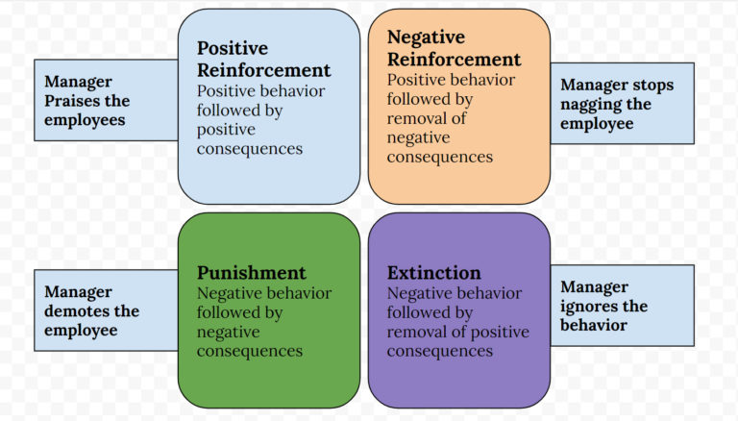
Reinforcement Theory
Reinforcement Theory, is a psychological and motivational theory that focuses on how behaviour is influenced and shaped by consequences.
It was developed by B.F. Skinner in the mid-20th century.
According to this theory, behaviour is a function of its consequences—behaviour that is followed by positive consequences tends to be repeated, while behaviour that is followed by negative consequences tends to be discouraged.
Image Source: Notes Learning
Notes:
https://noteslearning.com/reinforcement-theory-of-motivation/?utm_content=cmp-true

Slide 25
Reinforcement Theory
Reinforcement:
Reinforcement is a consequence that increases the likelihood of a behaviour being repeated. It can be positive or negative.
Positive Reinforcement: Providing a pleasant or rewarding consequence to encourage a desired behaviour (e.g., praise, promotions, bonuses).
Negative Reinforcement: Removing an unpleasant or aversive consequence to encourage a desired behaviour (e.g., removing an annoying task when a task is completed).
Image Source: Notes Learning

Slide 26
Reinforcement Theory
Punishment:
Punishment is a consequence that decreases the likelihood of a behaviour being repeated.
Positive Punishment: Introducing an unpleasant consequence to discourage an undesirable behaviour (e.g., reprimands, fines, penalties).
Negative Punishment: Removing a pleasant consequence to discourage an undesirable behaviour (e.g., loss of privileges).
Extinction:
Extinction involves the removal of reinforcement for a behaviour, leading to a decrease in the frequency of that behaviour.
Image Source: Notes Learning

Slide 27
Reinforcement Theory
Schedule of Reinforcement: This refers to the pattern or frequency of providing reinforcement.
Continuous Reinforcement: Reinforcement provided every time a behaviour is performed.
Partial Reinforcement: Reinforcement provided intermittently based on a certain pattern, such as fixed interval, variable interval, fixed ratio, or variable ratio.
Reinforcement Theory is widely used in organizations to motivate employees and influence their behaviour. Managers can reinforce desired behaviours by providing positive reinforcement in the form of rewards, recognition, or opportunities for growth. However, it's important to consider individual differences and ensure that the reinforcement is meaningful and relevant to the person being motivated. Additionally, understanding the timing and pattern of reinforcement is crucial in shaping behaviour effectively within an organizational context.
Image Source: Notes Learning

Slide 28
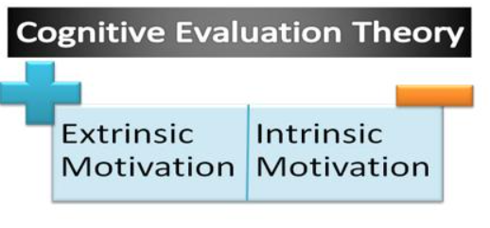
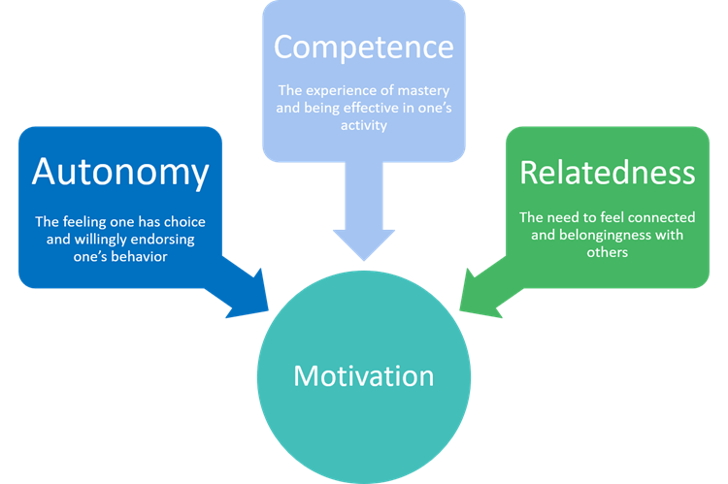
Cognitive Evaluation Theory
Cognitive Evaluation Theory (CET) is a psychological framework within the realm of self-determination theory that focuses on the role of intrinsic and extrinsic motivation in shaping human behaviour, particularly within the context of the workplace.
It was proposed by Edward L. Deci and Richard M. Ryan in the 1980s.
The theory explores how different types of rewards and feedback influence an individual's intrinsic motivation and overall engagement.
Image Source: Assignment Point
Image Source: Self Determination Model: URMC University of Rochester

Slide 29
Cognitive Evaluation Theory
Key components and concepts of Cognitive Evaluation Theory:
Intrinsic Motivation: Intrinsic motivation refers to engaging in an activity or behaviour because it is inherently enjoyable, interesting, or satisfying. The individual finds inherent value or pleasure in doing the task itself.
Extrinsic Motivation: Extrinsic motivation refers to engaging in an activity or behaviour to attain external rewards or avoid punishments. These rewards can be tangible (e.g., money, prizes) or intangible (e.g., praise, recognition).
Autonomy: Autonomy is the sense of control and choice an individual feels in determining their actions. Intrinsic motivation tends to flourish when individuals have a sense of autonomy.
Competence: Competence refers to an individual's perception of being capable and effective in performing a particular task or activity. Feeling competent enhances intrinsic motivation.
Relatedness: Relatedness involves feeling connected, valued, and understood by others. Social interactions and relationships play a significant role in shaping intrinsic motivation.

Slide 30
Cognitive Evaluation Theory
The Cognitive Evaluation Theory proposes two main processes through which extrinsic rewards can influence intrinsic motivation:
Competence Information: Extrinsic rewards or feedback that provide information about one's competence can enhance intrinsic motivation. When individuals receive positive feedback about their competence, it fosters a sense of mastery and boosts intrinsic motivation.
Autonomy Support: Extrinsic rewards or feedback that support an individual's sense of autonomy tend to promote intrinsic motivation. When individuals feel that they have control and choice in their actions, they are more likely to be intrinsically motivated.
If extrinsic rewards are perceived as controlling or undermining autonomy, they may diminish intrinsic motivation. The balance between extrinsic and intrinsic motivation is critical in influencing an individual's overall engagement, persistence, and performance in various activities.
In organizational settings, understanding how to design tasks, provide feedback, and use rewards in a way that supports autonomy and competence can enhance intrinsic motivation and, consequently, employee engagement and satisfaction.

Slide 31
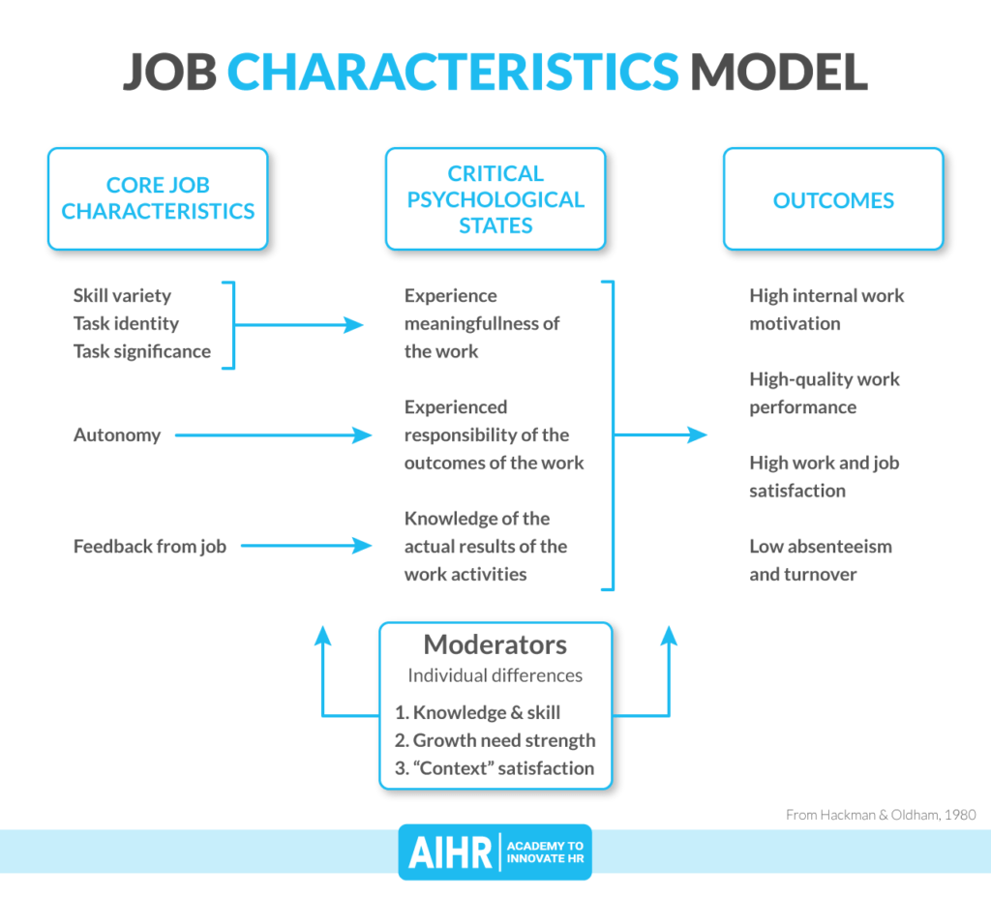
Job Characteristics Model
The Job Characteristics Model (JCM) is a framework developed by Hackman and Oldham in the 1970s, aiming to understand how specific characteristics of a job can impact an individual's motivation, satisfaction, and performance at work.
The model is based on the premise that jobs can be designed to be inherently motivating and engaging by incorporating key job characteristics.
The JCM identifies five core job characteristics and three psychological states that mediate the relationship between these characteristics and work outcomes.
Image Source: AIHR

Slide 32
Job Characteristics Model
Core Job Characteristics:
Skill Variety: The degree to which a job requires a variety of different activities and skills. A job high in skill variety allows employees to use a range of abilities and talents.
Task Identity: The extent to which a job involves completing a whole and identifiable piece of work. Jobs with high task identity provide a clear sense of accomplishment and ownership over a task.
Task Significance: The impact a job has on the lives or work of others, both within and outside the organization. Higher task significance leads to a sense of contributing to a meaningful purpose.
Autonomy: The degree of freedom, independence, and discretion an employee has in scheduling and performing their work. More autonomy gives employees a sense of control over their job.
Feedback: The extent to which employees receive direct and clear information about their job performance. Regular and constructive feedback enhances the employee's understanding of their effectiveness.
Image Source: AIHR

Slide 33
Job Characteristics Model
Psychological States:
Experienced Meaningfulness of Work: Refers to the degree to which the employee perceives their work as meaningful, valuable, and worthwhile. This is influenced by skill variety, task identity, and task significance.
Experienced Responsibility for Work Outcomes: The extent to which employees feel responsible and accountable for the results of their work. Autonomy significantly affects this psychological state.
Knowledge of Results: The degree to which employees are aware of the outcomes of their efforts. Feedback plays a crucial role in shaping this psychological state.
Image Source: AIHR

Slide 34
Job Characteristics Model
Outcomes:
The psychological states, influenced by the core job characteristics, ultimately lead to various work-related outcomes:
High Internal Work Motivation: Employees experience a strong desire to engage in their work and take personal ownership of their tasks.
High Job Satisfaction: Employees feel satisfied and content with their work due to the meaningfulness and significance attached to their job.
High Quality Work Performance: Employees are more likely to perform their work effectively and with a focus on quality.
Low Absenteeism and Turnover: Satisfied and motivated employees are less likely to be absent or leave their jobs.
Enhanced Well-being: Employees experience improved mental and emotional well-being due to the positive aspects of their job characteristics.
Image Source: AIHR

Slide 35
Job Characteristics Model
The Job Characteristics Model suggests that by modifying job characteristics to enhance skill variety, task identity, task significance, autonomy, and feedback, organizations can create more engaging and motivating work environments, leading to improved employee performance and satisfaction.
Image Source: AIHR

Slide 36
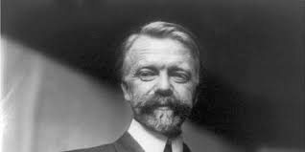

Fayol and Mintzberg
While both Henri Fayol and Henry Mintzberg are well-known management theorists, it's important to note that they did not develop specific organizational motivation theories as the primary focus of their work was on managerial roles and functions within organizations. However, their contributions and theories indirectly influence motivation within organizational contexts.
Image Source: Toolshero
Image Source: Mint

Slide 37
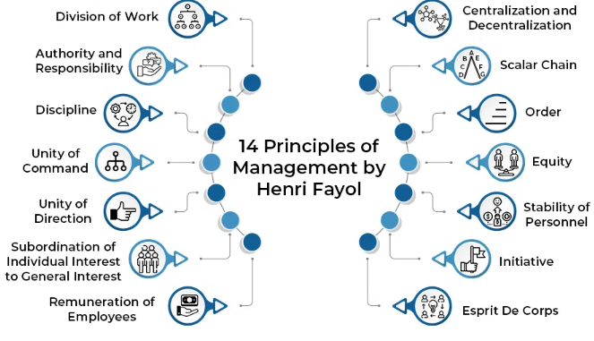
Fayol and Mintzberg
14 Principles of Management by Henri Fayol
Image Source: Geeksforgeeks

Slide 38
Fayol and Mintzberg
14 Principles of Management by Henri Fayol
Division of Work: Specialization and division of tasks based on skills and expertise to improve efficiency and productivity.
Authority: Managers must have the authority to give orders and make decisions, and this authority should match the responsibility they hold.
Discipline: Rules and guidelines ensure a disciplined work environment, promoting obedience and respect within the organization.
Unity of Command: Each employee should receive orders from only one superior, ensuring clarity and avoiding confusion.
Unity of Direction: All activities related to a specific goal should be under one coordinated plan to achieve unity and coordination.
Subordination of Individual Interest to the General Interest: The collective interest of the organization should take precedence over individual interests.
Remuneration: Fair compensation and benefits for employees to encourage motivation and job satisfaction.
Image Source: Geeksforgeeks

Slide 39
Fayol and Mintzberg
14 Principles of Management by Henri Fayol
Centralization: Determining the appropriate level of centralization in decision-making based on the organization's size and requirements.
Scalar Chain: Clear and formalized chain of authority from top to bottom within the organization for effective communication and coordination.
Order: A place for everything and everything in its place, emphasizing an organized workspace and process efficiency.
Equity: Fair treatment of employees, providing a sense of justice and impartiality in actions and decisions.
Stability of Tenure of Personnel: Minimizing employee turnover to ensure stability and efficiency in operations by providing job security and career growth.
Initiative: Encouraging employees to take the initiative and show creativity and innovation in their work.
Esprit de Corps: Fostering team spirit and harmony among employees to create a sense of unity and teamwork.
Image Source: Geeksforgeeks

Slide 40
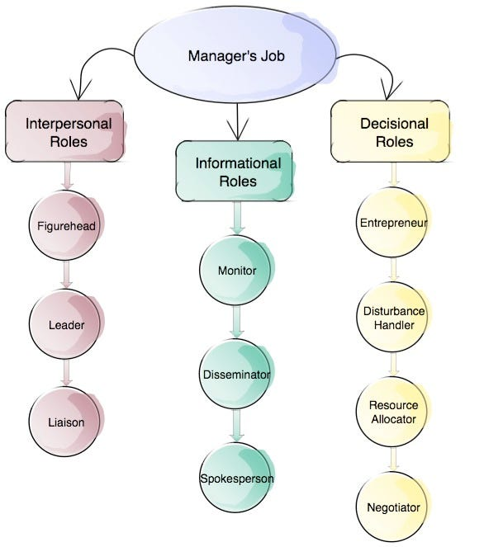
Fayol and Mintzberg
10 Roles of Manager Suggested by Henry Mintzberg
Interpersonal Roles
Figurehead:
The manager represents the organization in a symbolic or ceremonial capacity, often performing duties of a social or legal nature.
Leader:
The manager is responsible for providing guidance and direction to subordinates, fostering motivation and teamwork within the organization.
Liaison:
Managers interact and build relationships with people outside their unit or organization, often maintaining communication with peers and stakeholders.
Image Source: Medium

Slide 41
Fayol and Mintzberg
10 Roles of Manager Suggested by Henry Mintzberg
Decisional Roles
Entrepreneur:
Managers are responsible for initiating and overseeing innovation, change, and improvement within their unit or organization.
Disturbance Handler:
Managers are tasked with resolving conflicts or crises that disrupt the smooth functioning of the organization.
Resource Allocator:
The manager decides where resources (e.g., finances, personnel) should be allocated within the organization to achieve its objectives efficiently.
Negotiator:
Managers negotiate with stakeholders, other units, or external parties to reach agreements and ensure favourable outcomes for the organization.
Image Source: Medium

Slide 42
Fayol and Mintzberg
10 Roles of Manager Suggested by Henry Mintzberg
Informational Roles
Monitor:
Managers continuously gather information, both from internal and external sources, to stay informed about the organization and its environment.
Disseminator:
The manager shares information with team members and others in the organization, ensuring that relevant knowledge is communicated effectively.
Spokesperson:
Managers represent their organizational unit, conveying information to outsiders or stakeholders, and providing updates on organizational activities and decisions.
Image Source: Medium

Slide 43
Fayol and Mintzberg
Fayol's Influence on Organizational Motivation:
Henri Fayol's contributions primarily revolved around defining managerial functions and principles. Although he did not propose a formal motivation theory, his principles do have implications for motivation within organizations:
1. Unity of Direction:
Aligning individual and organizational goals to ensure a unified effort, which can enhance motivation. When employees understand how their tasks contribute to the broader objectives, they are more likely to be motivated to achieve them.
2. Esprit de Corps:
Encouraging team spirit and unity fosters a positive work environment, promoting motivation. A harmonious team atmosphere can significantly influence employee morale and motivation to contribute to the team's success.
3. Scalar Chain and Hierarchy:
Fayol's principle of scalar chain and hierarchical structure provides a clear communication and reporting structure. A well-defined hierarchy can reduce confusion and conflicts, contributing to a more motivated and organized workforce.
Mintzberg's Influence on Organizational Motivation:
Henry Mintzberg's work primarily focused on managerial roles and the functions managers perform. While he did not propose a motivation theory, his insights into managerial roles and leadership have implications for motivation:
1. Managerial Roles:
Mintzberg's managerial roles, especially the interpersonal roles (e.g., being a leader), directly influence employee motivation. Effective leadership is a key factor in motivating employees and creating a positive work environment.
2. Leadership Styles:
Mintzberg's approach emphasizes the significance of leadership in motivating employees. Different leadership styles (e.g., transformational, transactional) can have varying impacts on employee motivation, engagement, and job satisfaction.
3. Decisional Roles:
Making decisions effectively, one of Mintzberg's managerial roles, is critical for motivating employees. Employees feel motivated when they see that decisions are made fairly and based on input and consideration.
Notes:
Note: Scalar chain is the chain of all supervisors from the top management to the person working in the lowest rank. Scale chain identifies the path along which communication has to flow in order for the communication to be effective in an organisation.

Slide 44
Fayol and Mintzberg
While Fayol's principles emphasize creating a conducive work environment and a clear structure to enhance motivation, Mintzberg's managerial roles underscore the importance of leadership and effective decision-making. Integrating these aspects can contribute to a motivated and engaged workforce.
While Fayol and Mintzberg did not develop specific motivation theories, their managerial principles and roles have significant implications for understanding and fostering motivation within organizations by promoting effective communication, clear structure, strong leadership, and a positive work atmosphere.

Slide 45


Fayol’s Principles in Practice
General Electric (GE)
Unity of Direction: GE aligns its diverse businesses under a common corporate strategy and vision, ensuring a unified direction across the organization.
Scalar Chain and Hierarchy: The company maintains a clear hierarchical structure, emphasizing a well-defined chain of command and reporting relationships.
Procter & Gamble (P&G)
Division of Work: P&G assigns specific tasks and responsibilities based on expertise and specialization, optimizing performance and efficiency.
Unity of Direction: P&G emphasizes aligning individual objectives with organizational goals to ensure a unified direction in pursuit of its mission.
Image Source: General Electric
Image Source: Procter & Gamble

Slide 46


Mintzberg's Managerial Roles in Practice
Apple Inc.
Interpersonal Roles: Apple's CEO and leadership team often play the roles of figureheads and leaders, representing the organization and setting the strategic direction.
Decisional Roles: Apple's leadership is heavily involved in decision-making, especially concerning product innovation and market strategies.
Amazon
Interpersonal Roles: Former Amazon's CEO 2021, Jeff Bezos (at the time of this writing), played significant roles as a leader and liaison, driving the company's vision and establishing partnerships.
Informational Roles: Amazon's executives, particularly in data-driven areas like logistics and e-commerce, act as monitors and disseminators, ensuring the efficient flow of information within the organization.
Image Source: Apple
Image Source: Amazon
Notes:
Current CEO since July 5 – 2021 Andy Jassy

Slide 47
Learning Objectives Completed
Define what motivation is in relation to the workplace
Understand the different motivation theories
Fayol's and Mintzberg's Approaches to Management Roles: Significance of Motivation and Structure in Organizations
Image Source: Institute of Entrepreneurship Development

